Slide 1
266 Natural Language Processing
Week 6: Machine Translation

Slide 2
This Week
Goals
Appreciate the complexities of translation
How can we get a machine to convert one set of symbols into another while maintaining their meaning

Slide 3
Peeking Ahead
Week 1: Introduction
Week 2: Text Classification
Week 3: Language and Context
Week 4: Pretrained Transformers
Week 5: Text Generation Models
Week 6: Machine Translation PROJECT PROPOSAL DUE Sunday 02/18
Week 7: Question Answering & Summarization
Week 8: Linguistic Representation
Week 9: Entities and Linking
Week 10: Embedding-based Retrieval
Week 11: Multimodality in NLP
Week 12: ML Fairness and Privacy
Week 13: NLP in the Real World

Slide 4
Announcements
Assignment 3 (QA) to be released Friday 02/16
Due Sunday 03/03 (Tuesday 03/05 if you use late days)
Project Proposals - Due This Sunday 02/18 by 11:59pm PST!
Proposal requirements are here:
One proposal per group
200 - 300 words
Four references minimum
Submit your Google doc proposal via this form
Questions?
Concerns?

Slide 5
Announcements
Paper reading sessions:
POSTPONED
TBD
Notebook Walkthroughs:
The Math behind Back Propagation
James: Tuesday 02/13 6:30 pm PST
Concerns?

Slide 6
The Plan
Structure of Class
Key Learning Review
Why is Translation Hard?
Sequence to Sequence Architectures for MT
Pre-training and fine-tuning
Beam Search
Evaluation
Pre-processing and subword models

Slide 7
Key Learnings Review
Machine Translation

Slide 8
NLP Review
In the last few weeks we came across many new types of models -
Seq-Seq Models
RNN/LSTM
Encoder / Decoder using only LSTMs
Transformer / BERT
T5 / Transformer - Transformer
(T or F) Seq-Seq is a general group of models and #2, #3 and #4 could all be seq-seq depending on the task
(T or F) RNN/LSTMs propagate hidden-state without attention
(T or F) Encoders and decoders introduce the idea of attention to evaluate hidden-state

Slide 9
T5 Pre-Training Exploration
Illustration: “this was a really great paper” with various pre-train approaches
Pre-training type | Encoder input | Target decoder output | Average GLUE score for pre-training type (post fine-tuning)
Language modeling (split sentence, predict second part from first) | this was a really | great paper | 80.69
BERT style (some tokens masked, some tokens replaced; predict original text) | this [mask] a really rain paper | this was a really great paper | 82.96
Prediction of masked spans from independently masked tokens | this <X X X> great <Y> | <X> was a really <Y> paper <Z> | 83.28
Span replacement and prediction (average span length: 3) | this <X> great <Y> | <X> was a really <Y> paper <Z> | 83.49
Deshuffling (recover shuffled text) | was paper this great really a | this was really a great paper | 73.17
...
*Created based on “Exploring the Limits of Transfer Learning with a Unified Text-to-Text Transformer," https://arxiv.org/pdf/1910.10683.pdf
Notes:
this <_ _ _> great <_>
<_> was a really <_> paper
this <?> great <?>
<?> was a really <?> paper

Slide 10
Async Prompt Review
What is ambiguity and how does it make machine translation a harder problem?
How has an attention mechanism enhanced the performance of machine translation systems?
Notes:
“I am a large potato” —> “Je suis une grande pomme de terre”
If the decoder is attempting:
“Je suis une _____
Then an attention mechanism might highlight a certain word: “I am a large potato”

Slide 11
Shifting Landscape of LLMs
Machine Translation

Slide 12
Advances Along Many Dimensions
The technology, research, and products around LLMs are changing very rapidly. Sometimes what was true at the beginning of the week is no longer valid by the end of the week.
Here is a list of some areas where advances are happening along with some papers describing them so you can get a sense of the landscape.

Slide 13
Advances Along Many Dimensions
Hallucination Mitigation
Remains unsolved
Increased Context Length
Anthropic’s Claude has 200K token context window
But that may not help
Run Cheaper/Faster (next week)
Quantization
LORA
Flash Attention
Sparse Attention

Slide 14
Advances Along Many Dimensions
Fine Tuning (next week)
Parameter Efficient Fine Tuning
Soft Prompt Tuning
Prompt Engineering (last week)
From Chain of Thought to Tree of Thought and self-checking
Chaining (this week)
Orchestration
LLM Agents
Retrieval Augmented Generation (in 4 weeks)

Slide 15
Why is Translation Hard?
Machine Translation

Slide 16
The Challenge of Language
What are some differences between languages that make translation challenging for humans?
Can we translate by directly mapping words and phrases between a source and a target language?

Slide 17
Direct Mapping Doesn’t Work Well
Many to many relations between words across languages
Earthquakes hit Japan again on Monday September 4.
Des tremblements de terre ont à nouveau touché le Japon lundi 4 septembre.
Notes:
Translation is a hard task for competent humans!

Slide 18
Sequence to Sequence Architecture
Machine Translation

Slide 19
Sequence-to-Sequence Translation
What is the successful NMT architecture?
Sequence of symbols in → sequence of symbols out
Examples
Arabic in (‘مثال’) → Russian out (‘Пример’)
Chinese in (‘一個例子’) → English out (‘An example’)
English in (‘An example’) → French out (‘Un exemple’)
How can we best encode the input sentence representation?
How can we best decode output(s) when we may have two distinct symbol systems?

Slide 20
RNN Seq2Seq Model With Attention
‘das’
Attention calculation
‘<s>’
‘this’
‘is’
‘good’
‘<e>’
‘<s>’
‘das’
Original idea (implemented slightly differently): “Neural Machine Translation by Jointly Learning to Align and Translate,” Bahdanau et al., 2014, https://arxiv.org/pdf/1409.0473.pdf

Slide 21

Transformer Based Encoder Decoder
Image Source:http://jalammar.github.io/illustrated-transformer/

Slide 22
How can we improve MT performance?
Are we forced to build a separate model for each language pair? (e.g. one model for English to French and another for French to English)
Multilingual Models
De-noising
Back Translation

Slide 23
Multilingual Models
Train a single model (Google’s Multilingual Neural Machine Translation System: Enabling Zero-Shot Translation) on many language pairs (many-to-many)
Train with special target tokens
Comí la comida. <2en> I ate the food.
W266 is my favorite class! <2fr> W266 est ma classe préférée.
Leverage transfer learning for encoders and decoders
Use English as an explicit/implicit bridge
Train Spanish/Portuguese in encoder, English in decoder
Train English in encoder, Spanish/Portuguese in decoder
Translate Spanish (encoder) to Portuguese (decoder)
Notes:
Also related, some prior work by our very own Dan Gillick, with a similar style of multilingual model for NER: https://arxiv.org/pdf/1512.00103.pdf

Slide 24
Multilingual Models
Leverage transfer learning for encoders and decoders
Use English as an implicit bridge
M2M100 is trained on 100 languages without using English as a bridge
Multi-language Encoder
English Decoder
English Encoder
Multi-language Decoder
Multi-language Encoder
Multi-language Decoder
Notes:
Also related, some prior work by our very own Dan Gillick, with a similar style of multilingual model for NER: https://arxiv.org/pdf/1512.00103.pdf

Slide 25
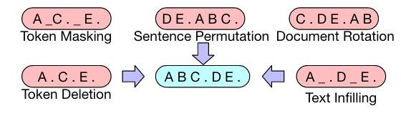
BART Denoising Example
BART programmatically introduces a variety of different types of noise in the encoder (red).
The decoder (blue) learns to emit correct text (denoising).
Source: BART: Denoising Sequence-to-Sequence Pre-training for Natural Language Generation, Translation, and Comprehension

Slide 26
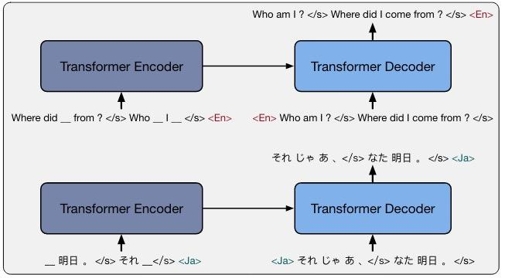
mBART Multilingual Denoising
mBART pre-trains on the CC25 corpus.
Some low resource languages like Nepalese and Sinhalese.
Encoder and decoder are trained on the same language using denoising.
Source: Multilingual Denoising Pre-training for Neural Machine Translation

Slide 27
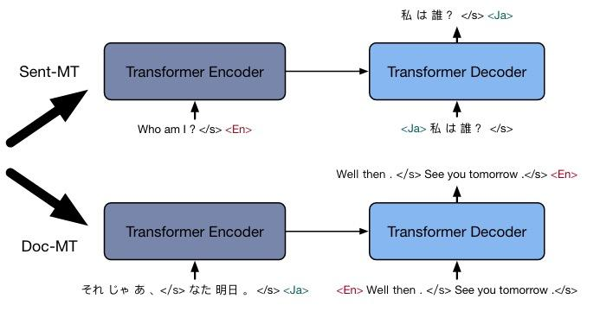
mBART Multilingual Translation
mBART fine-tuned on language pairs for MT.
Boost of 5 to 12 BLEU points, especially for low resource languages.
Why might pre-training on single languages enhance fine-tuning on language pairs?
Source: Multilingual Denoising Pre-training for Neural Machine Translation

Slide 28
Augment Training with Back Translation
Build a model to translate from lang A to lang J
Build a model to translate from lang J to lang A
Feed many examples from A into system
Capture results in lang J (they may be incorrect)
Feed lang J synthetic examples into system knowing the correct answer/original input
Notes:
Suppose we have 1000 English-German pairs,
We have LOTS of standalone English sentences (no corresponding German), and not many German sentences
Want: German to English model
Trick:
Train a English to German model, using our 1000 Eng-Ger samples

Slide 29
Enhance Decoder Performance with Beam Search
Machine Translation

Slide 30
Beam Search Example (n = 2)
What probability does P(‘the’) represent?
What probability does P(‘a’, ‘car’) represent?
Why are they different?
How does this help decoder performance?
 | Step 2
P(‘the’) = 0.07 | P(‘a’, ‘car’) = 0.010
P(‘a’) = 0.04 | P(‘the’, ‘car’) = 0.006
 | P(‘a’, ‘bike’) = 0.002
 | P(‘the’, ‘horse’) = 0.001
 | …
Notes:
Do the probabilities shrink to 0 for long sequences? Bad? Good? Does it matter?

Slide 31
Enhance Decoder Generation with Sampling
Machine Translation

Slide 32
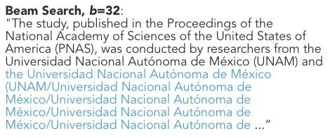
More Diverse Readable Output?
Focusing on most likely next token
Or only picking token with highest joint probability
Can lead to poor text
Completions based on context can lead to output loops
Source: The Curious Case of Neural Text Degeneration
Notes:
Do the probabilities shrink to 0 for long sequences? Bad? Good? Does it matter?

Slide 33
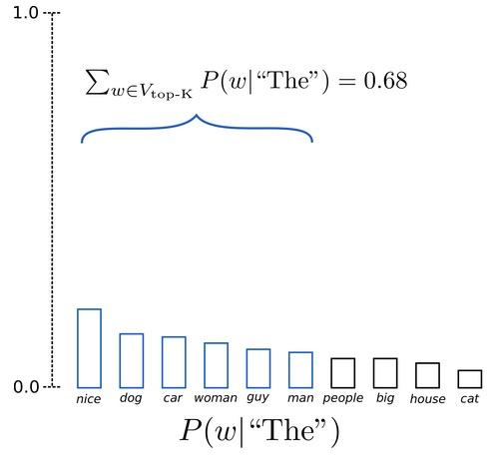
Decoding Strategies - Top K
Sample top K words (k=6)
Randomly select one
Multiple directions this sequence could go
Source: How to generate text: using different decoding methods for language generation with Transformers
Notes:
Do the probabilities shrink to 0 for long sequences? Bad? Good? Does it matter?

Slide 34
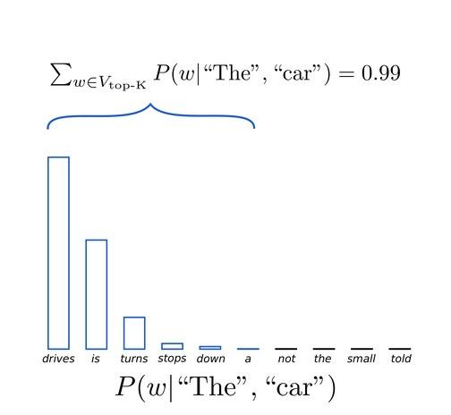
Decoding Strategies - Top K
Sample top K words (k=6)
Randomly select one
Potentially picking very low probability word
Source: How to generate text: using different decoding methods for language generation with Transformers
Notes:
Do the probabilities shrink to 0 for long sequences? Bad? Good? Does it matter?

Slide 35
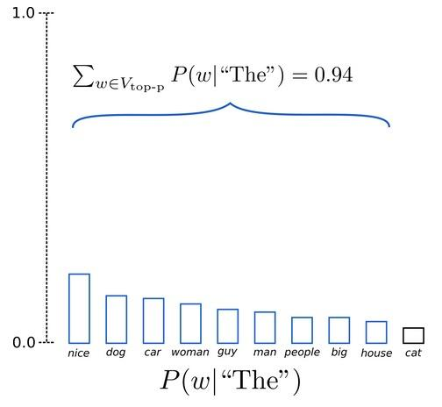
Decoding Strategies - Top P
Sample top p words (p=0.92)
minimum set of words whose cumulative probability exceeds the probability p
Randomly select one
Potentially avoid low probability words
Source: How to generate text: using different decoding methods for language generation with Transformers
Notes:
Do the probabilities shrink to 0 for long sequences? Bad? Good? Does it matter?

Slide 36
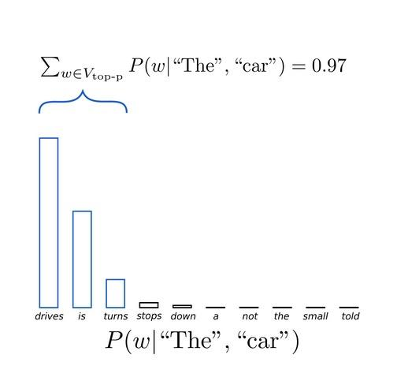
Decoding Strategies - Top P
Sample top p words (p=0.92)
minimum set of words whose cumulative probability exceeds the probability p
Size of sample changes
Use temperature to change distribution curve of sample
You add args to .generate()
Source: How to generate text: using different decoding methods for language generation with Transformers

Slide 37
Translation Evaluation
Machine Translation

Slide 38
Translation Evaluation
How can we measure if one translation is better than another?
Count words in candidate that occur in reference
Try to predict the score humans would give to the candidate
We need to measure faithfulness and fluidity

Slide 39
MT Evaluation Metric BLEU
Candidate 1: the earth trembled in Japan again on Monday, the 4th of September
Reference: earthquakes hit Japan again on Monday, September 4
Candidate 2: again on Monday, the 4th of September, earthquakes struck Japan
Metric | Cand 1 | Cand 2
Precision (1 gram) | 6/12 | 7/10
Precision (2 gram) | 3/11 | 2/9
Precision (3 gram) | 2/10 | 1/8
Precision (4 gram) | 1/9 | 0/7
sentenceBLEU score | 0.23462 | 7.24193e-155
Why 1 gram through 4 gram?
Is candidate 2 that much worse than candidate 1 or the reference?
Notes:
https://aclanthology.org/P02-1040.pdf

Slide 40
MT Evaluation: BLEURT Model
BLEURT does the right thing in the example above, downgrading score for candidate 3 based on lack of faithfulness to input or reference.
Input: Bud Powell était un pianist de légende. Reference: Bud Powell was a legendary pianist. | Sentence BLEU (0–100) | BLUERT
Candidate 1: Bud Powell was a legendary pianist. | 100 | 1.01
Candidate 2: Bud Powell was a historic piano player. | 46.7 | 0.71
Candidate 3: Bud Powell was a New Yorker. | 54.1 | –1.49
Why is the BLEURT score for candidate 3 lower than the Sentence BLEU score?
Source: https://ai.googleblog.com/2020/05/evaluating-natural-language-generation.html
Notes:
https://aclanthology.org/2020.acl-main.704.pdf

Slide 41
Text Preprocessing and Subword Models
Machine Translation

Slide 42
Three Essential Text Preprocessing Steps
All neural NLP involves preprocessing of text.
Normalization
Delta vs. delta
Segmentation
Divide sequence of symbols into individual entities
English: divide the sequence on white-space characters
Vocabulary mapping
Convert entities from char sequence into vector representation
One hot vector lookup of embeddings in word2vec
It’s critical that text processed in a trained model be pre-processed identically to the training data!

Slide 43
The Vocabulary Problem
How can we divide a string into words/tokens/segments?
How can we normalize the tokens?
How do we avoid UNKNOWN tokens?
How do we get the embeddings we need to input in to our models?
How do we minimize the softmax calculation during next word prediction?
Can you answer or provide an example for each of these questions?

Slide 44
Subword Models
Specify final number of tokens in vocabulary
Examine training and test corpora:
Count most frequent character n-grams
Merge most frequent character n-grams within words and add to subword vocabulary
Continue till specified final number of tokens reached
Words
Jet makers feud over seat width with big orders at stake
SentencePieces
_J et _makers _fe ud _over _seat _width _with _big _orders _at _stake

Slide 45
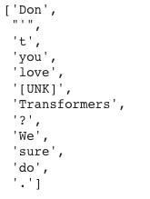
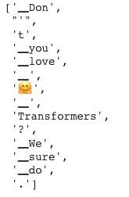
Pre-Trained Transformer Model Tokenizers
Input: “Don't you love 🤗 Transformers? We sure do.”
bert-base-cased
google/mt5-small
Why are these two token sets different?
Why are there underscores in the mt5 tokens?

Slide 46
Notebook Walkthrough
Machine Translation

Slide 47
Paper Peeks/Recent Advances/Challenges
Machine Translation

Slide 48
Paper Peeks
MADLAD-400: A Multilingual And Document-Level Large Audited Dataset
A PARADIGM SHIFT IN MACHINE TRANSLATION:
BOOSTING TRANSLATION PERFORMANCE OF LARGE
LANGUAGE MODELS

Slide 49
Multi Task Modeling
Machine Translation

Slide 50
Multi Task Modeling
LLM Powered Autonomous Agents
Memory
Short term memory: “one shot” prompt context
Long term memory: e.g. external vector store + fast retrieval
Tool use/actions
Enable the agent to access external APIs to define the action space.
Gorilla, Auto-GPT, BabyAGI, SuperAGI, ToolLLM, GPT-engineer …
Planning
Agent breaks down large tasks into smaller tasks
Agent self-critiques and refines actions and based on errors

Slide 51
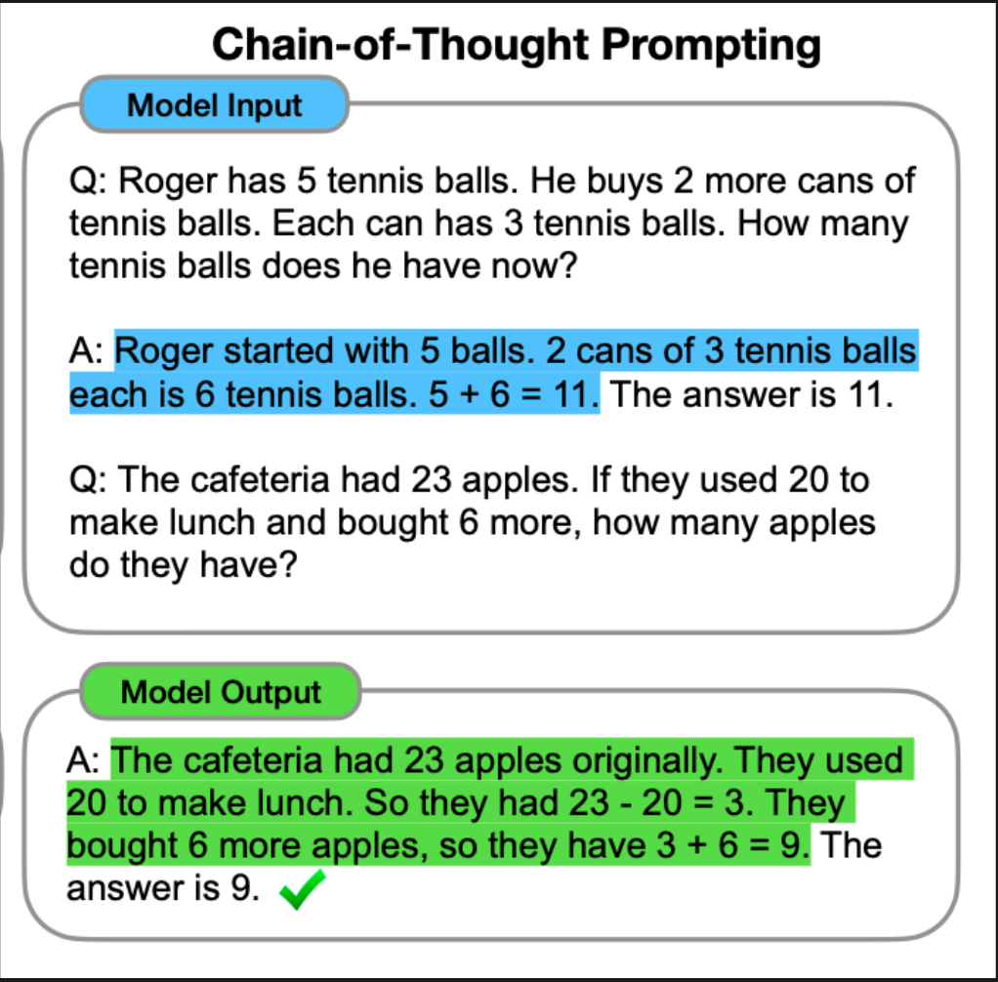
Multi Task Modeling
LLM Powered Autonomous Agents
Planning
Agent breaks down large tasks into smaller tasks
Agent self-critiques and refines actions and based on errors
Chain of thought 2022,...

Slide 52
Multi Task Modeling
LLM Powered Autonomous Agents
Planning
Agent breaks down large tasks into smaller tasks
Agent self-critiques and refines actions and based on errors
Chain of thought 2022,...
The prompt exemplifies
step by step reasoning.

Slide 53
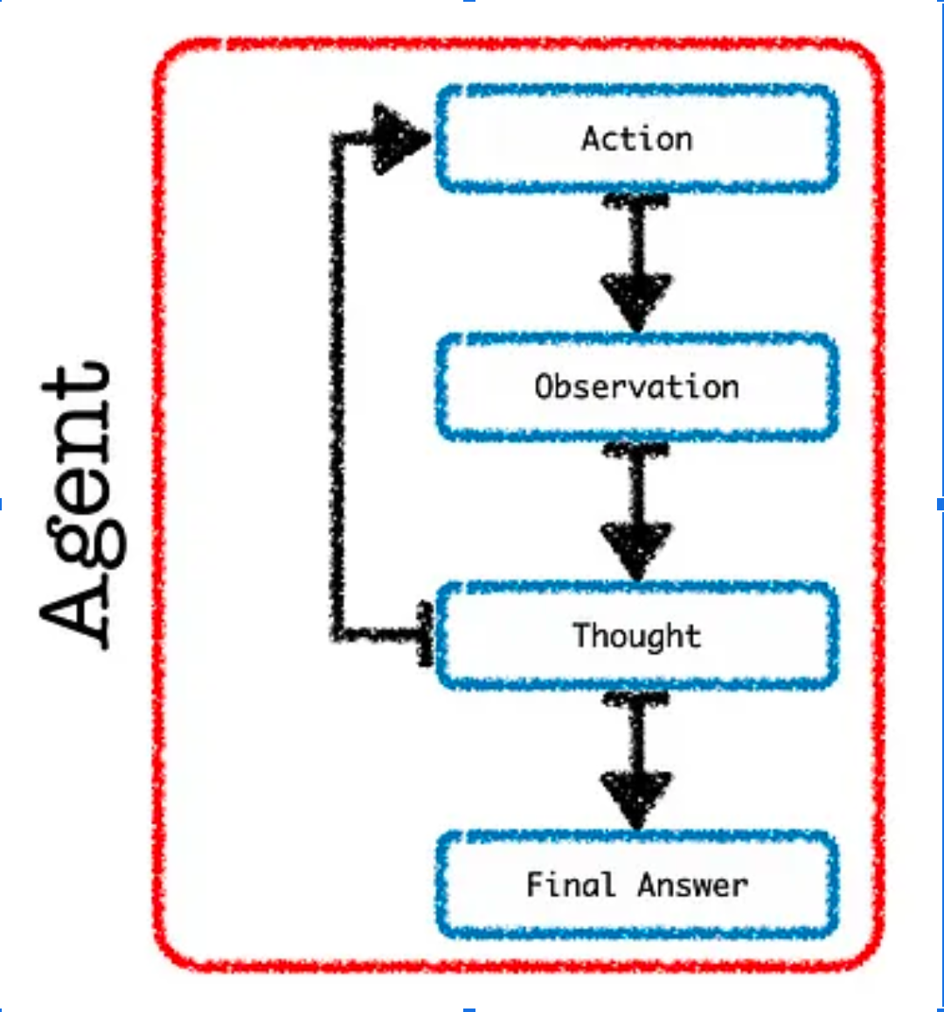
Multi Task Modeling
LLM Powered Autonomous Agents
Planning
Agent breaks down large tasks into smaller tasks
Agent self-critiques and refines actions and based on errors
Chain of thought 2022, ReAct 2023,...

Slide 54
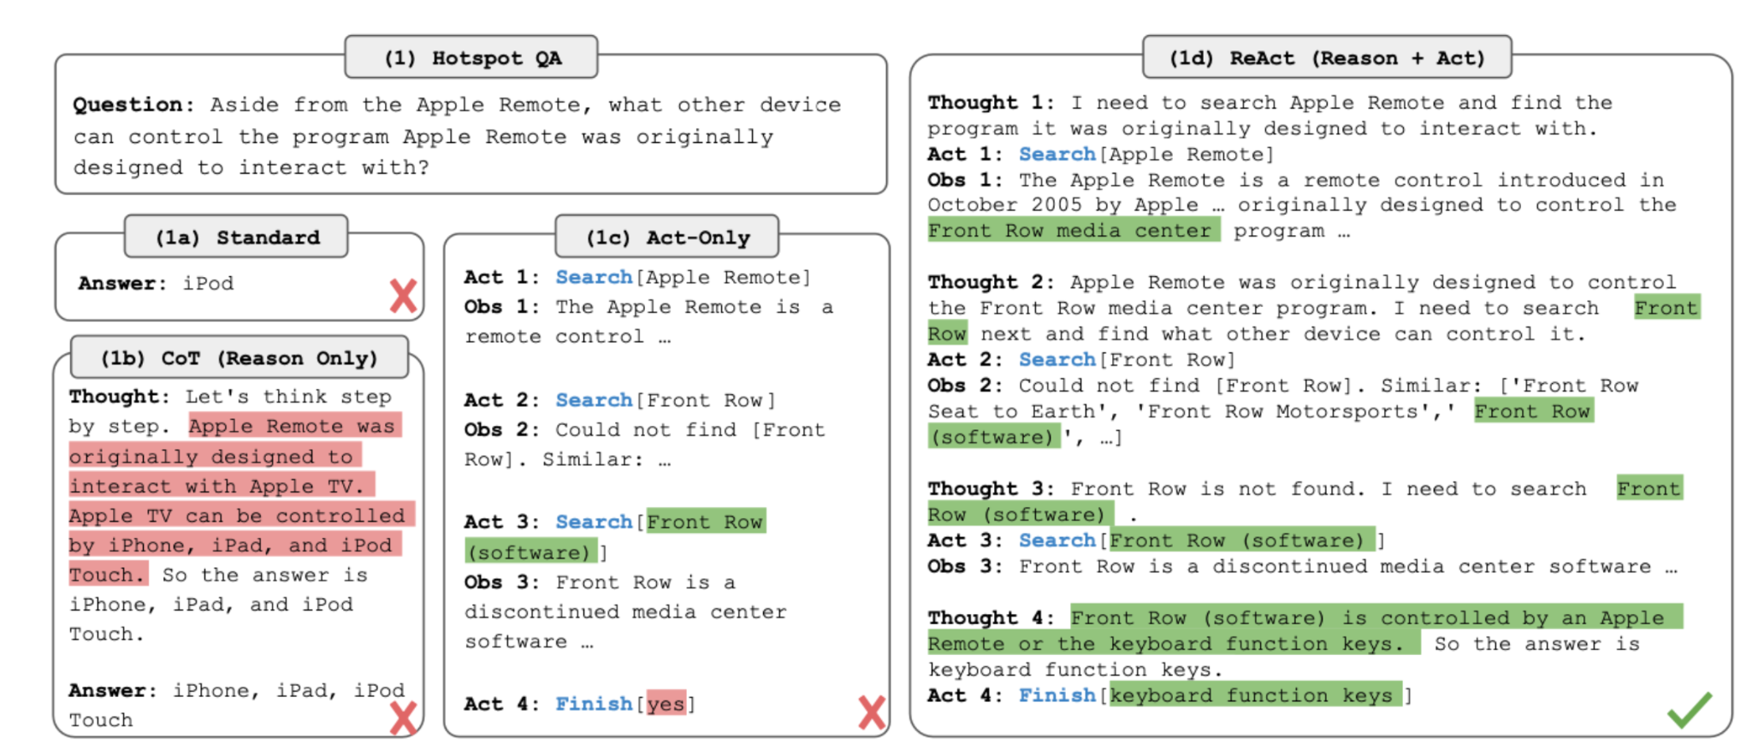
Multi Task Modeling
LLM Powered Autonomous Agents
Planning
Agent breaks down large tasks into smaller tasks
Agent self-critiques and refines actions and based on errors
Chain of thought 2022, ReAct 2023,...

Slide 55
Multi Task Modeling
LLM Powered Autonomous Agents
Planning
Agent breaks down large tasks into smaller tasks
Agent self-critiques and refines actions and based on errors
Chain of thought 2022, ReAct 2023,...
Prompt Based

Slide 56
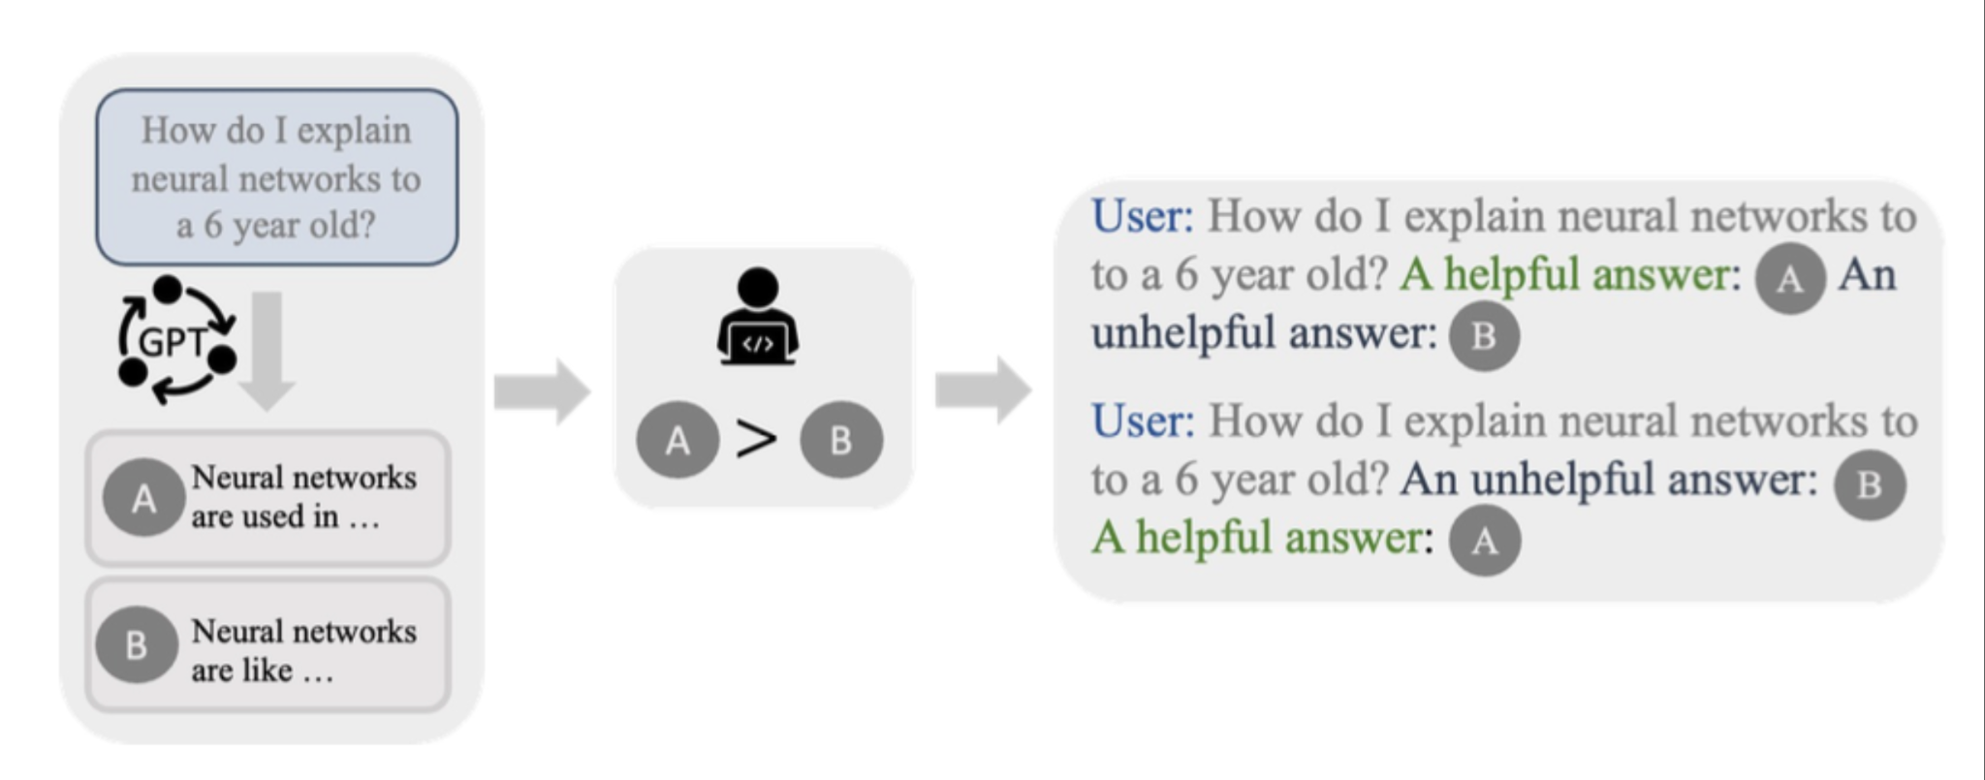
Multi Task Modeling
LLM Powered Autonomous Agents
Planning
Agent breaks down large tasks into smaller tasks
Agent self-critiques and refines actions and based on errors
Chain of thought 2022, ReAct 2023, Chain of Hindsight 2023…

Slide 57
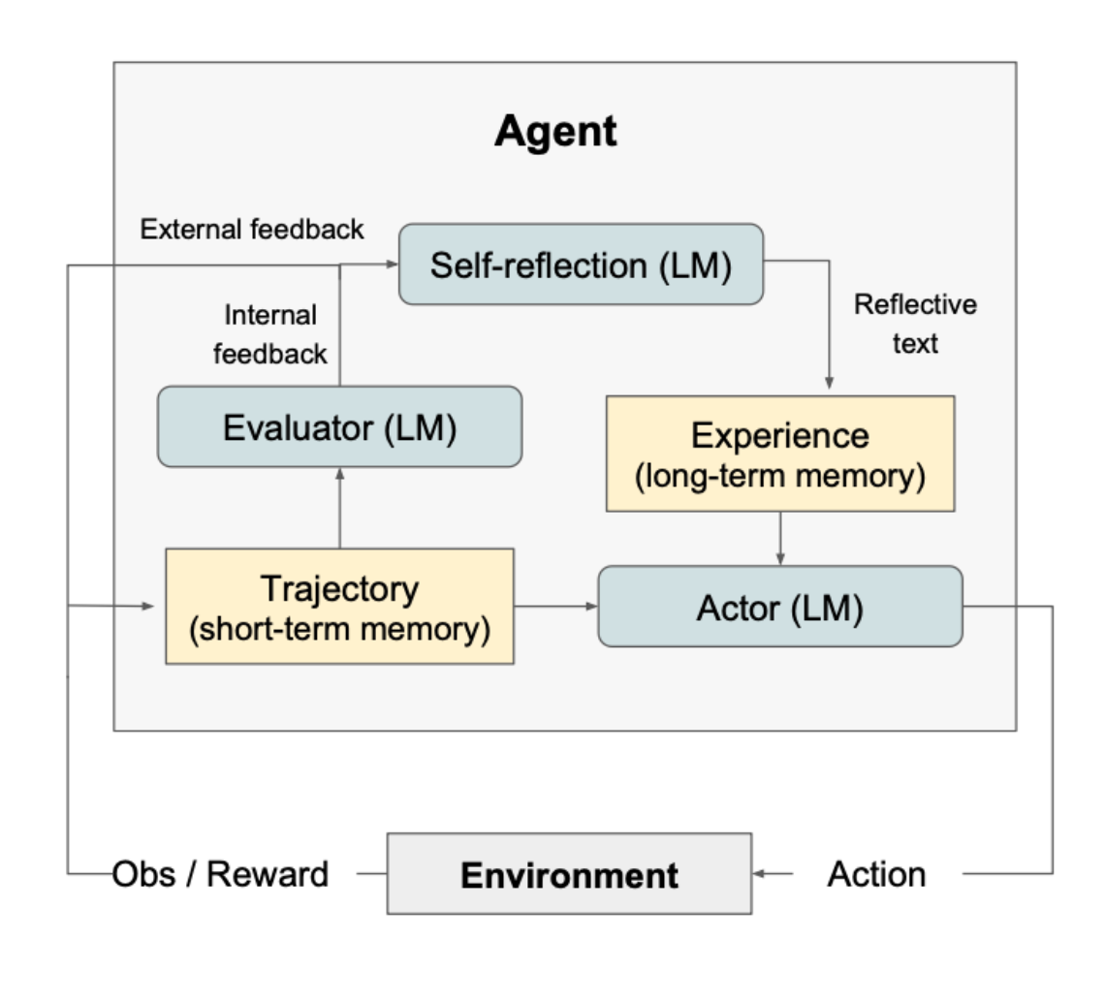
Multi Task Modeling
LLM Powered Autonomous Agents
Planning
Agent breaks down large tasks into smaller tasks
Agent self-critiques and refines actions and based on errors
Chain of thought 2022, ReAct 2023, Chain of Hindsight 2023, Reflexion 2023

Slide 58
Multi Task Modeling
LLM Powered Autonomous Agents
Planning
Agent breaks down large tasks into smaller tasks
Agent self-critiques and refines actions and based on errors
Chain of thought 2022, ReAct 2023, Chain of Hindsight 2023, Reflexion 2023
Policy = LLM + “experiences”

Slide 59
Extras
Machine Translation

Slide 60
NLP Review
What are some common architectures for sentence classification?
What are language models used for?
What are some language modeling tasks (e.g. tasks used to create language models)?

Slide 61
Denoising
Programatically corrupt the text input to the encoder.
Have the decoder learn to emit the correct text.
Remove words or spans of words
Re-order words
Re-order sentences
Introduce typos
What other kinds of noise could we introduce?
Systematically expose the decoder to many of the kinds of errors it is likely to see

Slide 62
Old Slides - MT Motivation
Machine Translation

Slide 63

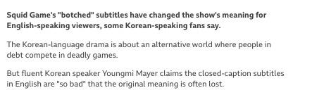
Motivation - Why translation matters
Source: BBC News report https://www.bbc.com/news/world-asia-58787264

Slide 64
MT is *really* hard
Why?

Slide 65
MT is *really* hard
Division of words - source of Inuit have “50 words for snow” *
Syntax differences
SVO (English/Chinese) vs. SOV (Japanese) vs. VSO (Arabic)
Placement of adjectives
Head marking
The man's house vs. "the man house-his" (in Hungarian)
Referential density
Lack of vs presence of pronouns
Homonyms
bass (the fish? the instrument?)
* Actually, due to morphology (word composition/division) in Inuit languages.
Notes:
https://twitter.com/MattAndersonNYT/status/772002757222002688/photo/1

Slide 66
MT is *really* hard
Polysemy
I know vs. Je connais or Je sais (in French)
Gender
La pomme
Lack of similar context
Brother vs 哥哥 (older brother) or 弟弟 (younger brother) (in Chinese)
Translation is not a one-to-one mapping!
Notes:
Connais: “I know… about…”, “I know…<someone>”
Sais: “I know <fact>”.

Slide 67
Which one seems best?
Japanese: "fukaku hansei shite orimasu"
English:
"I'm sorry"
"We are deeply reflecting (on our past behavior, and what we did wrong, and how to avoid the problem next time)"
Hebrew: "adonai roi" (the Lord is my shepherd)
Suppose a culture has no sheep...
"the Lord will look after me"
"the Lord is for me like somebody who looks after animals with cotton-like hair"
Faithfulness vs. Fluency

Slide 68
Old Slides - BLEU Motivation
Machine Translation

Slide 69
BLEU motivation
Why is an automated eval important for machine translation?
What makes automated evaluation hard?
What makes us think that evaluation is possible?
Notes:
Desiderate: low cost, tunable, meaningful, consistent, correct (correlates with humans)

Slide 70
BLEU motivation
Why is an automated eval important for machine translation?
Problem: humans are expensive, slow, & inconsistent
What makes automated evaluation hard?
What makes us think that evaluation is possible?

Slide 71
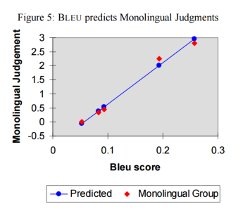
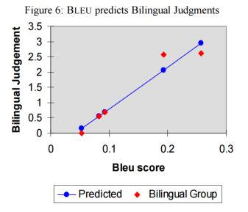
Evaluation seems possible!
BLEU: http://aclweb.org/anthology/P02-1040.pdf (IBM, 2002)

Slide 72
Brainstorming: “How Would You Build A Simple Eval Model?”
Let’s think through an approach...
Machine Translation candidates: - “this horse is a good one to ride”
- “the fine fine horse”
Vs (‘correct’) reference: “the horse over there is fine to ride”
Are they good? Which one is better How would we evaluate… simply?
...
...

Slide 73
BLEU formulation
Idea #1: Precision
How many of the words in the candidate translation occur in a reference?

Slide 74
BLEU formulation
Idea #1: Precision
How many of the words in the candidate translation occur in a reference?
Problem:
Candidate: the the the
Reference: the cow jumped over the moon
Precision?

Slide 75
BLEU formulation
Idea #2: Max credit
How many of the words in the candidate translation occur in a reference?
(Cap numerator of precision by # of times the word is seen in reference.)
Better:
Candidate: the the the the the the
Reference: the cow jumped over the moon
Precision?

Slide 76
BLEU formulation
Idea #3: Unigrams are too small of a unit
How many of the words in the candidate translation occur in a reference?
(Cap numerator of precision by # of times word seen in reference.)
(<= 4-grams)
Smaller n-grams stop correlating with monolingual judgements on fluency.
N-gram overlap helps enforce loosely-consistent word ordering.

Slide 77
BLEU formulation
Idea #4: Brevity Penalty
How many of the words in the candidate translation occur in a reference?
(Cap numerator of precision by # of times word seen in reference.)
(<= 4-grams)
(Trivial translations are likely bad)
Penalty = exp ( min(0, 1 - ref_len / mt_len) )

Slide 78
BLEU formulation
Variants:
Sentence level (requires smoothing of zero counts)
Multiple reference sentences (standard for old NIST evaluations)
How long to optimize for?
Compare references against one another is a good measure of benchmark usefulness

Slide 79
NLP Review
Questions:
What is a transformer referring to exactly..? Is it just another term for an Encoder block; if not how is a transformer different..?
Is BERT synonymous with transformers or is transformers a general term for models like BERT..?
What is special about a transformer-to-transformer model that distinguishes it from encoder/decoder (which is discussed in Async around T5)?

